Slide 1
HN Regalia
Monthly Report
Dt: 1st March 2022 – 31st March 2022

Slide 2
Synopsys
Things carried out in the project.
Social media data representation.
GMB data representation.
Current bottlenecks in the project and possible resolutions
Next course of action.

Slide 3
Utility Chart
- March 1-10 day 2022
We've set up Facebook and Instagram pages, as well as updated all of the information.
March 11-31 day 2022
We've started our postings.

Slide 4
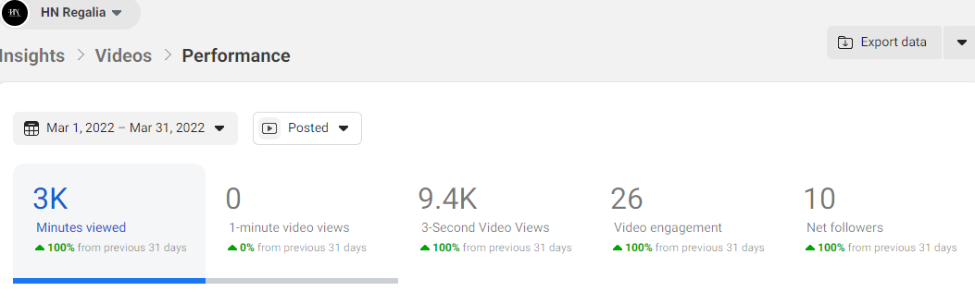

Slide 5
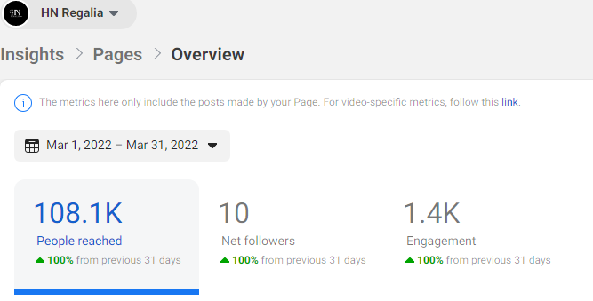

Slide 6
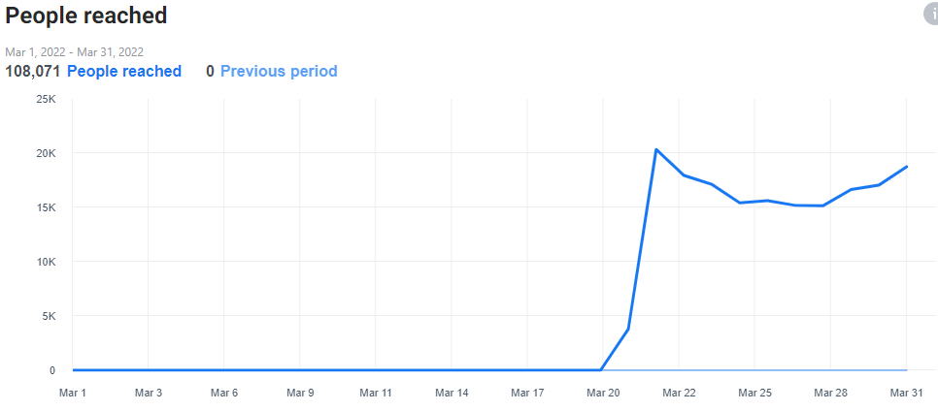
Total Reach

Slide 7
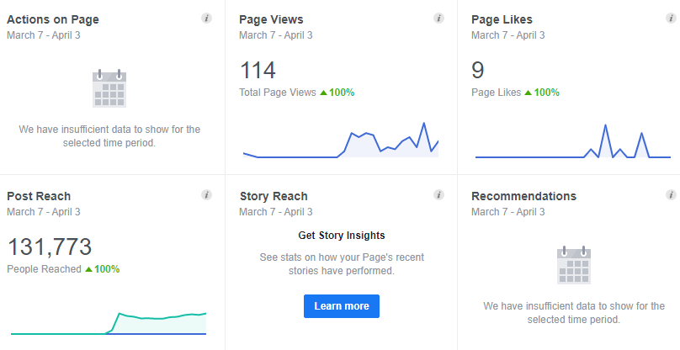

Slide 8
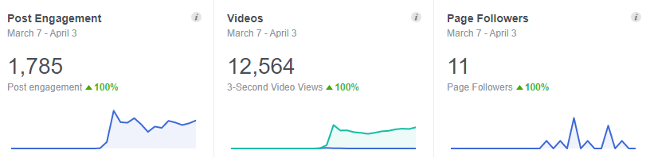

Slide 9
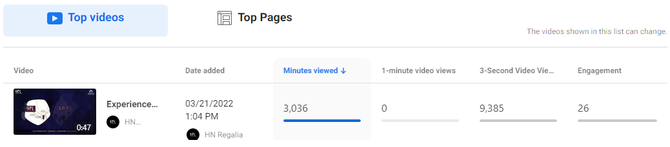

Slide 10
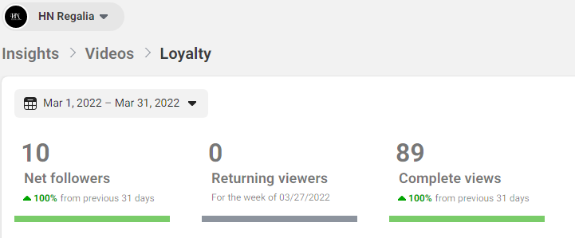

Slide 11
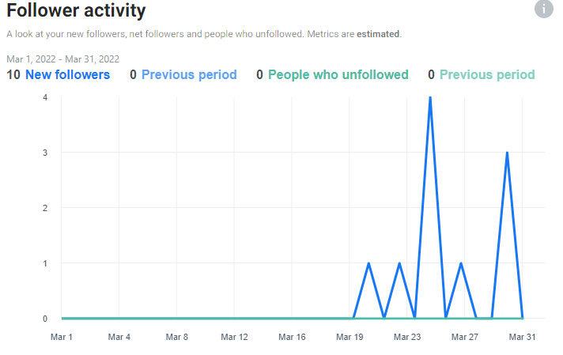

Slide 12
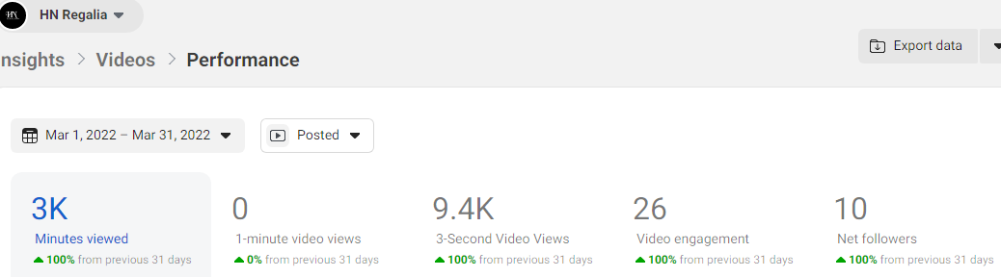

Slide 13
Numbers from Facebook
Reach - 154341
Impression - 171863
Views - 125
All Clicks - 1225
Page Engagement- 1133

Slide 14
Numbers from Instagram
Reach - 22,067
Account engaged - 19

Slide 15
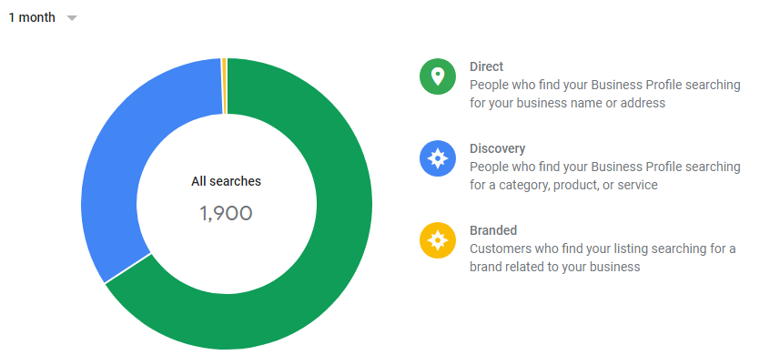
Numbers from Google My Business

Slide 16
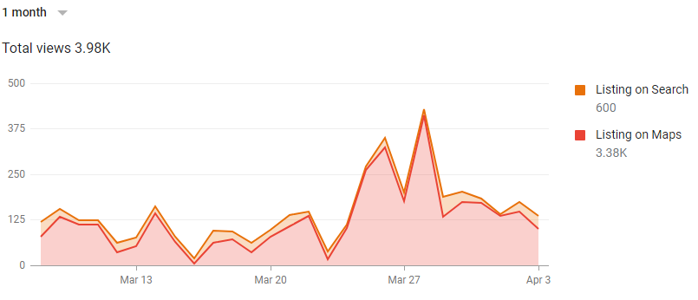

Slide 17
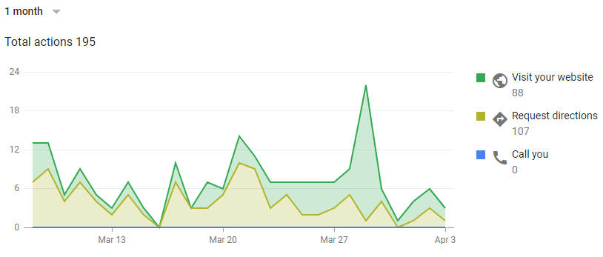

Slide 18
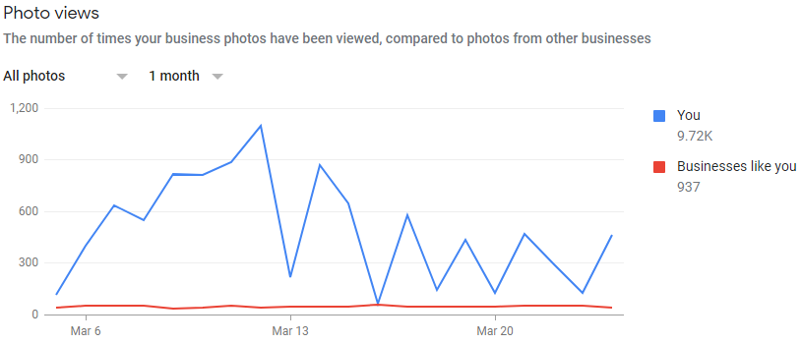

Slide 19
Findings
The impressions are being achieved at a decent numbers.
We are generating the views and impression but recall has not been established yet.
CTR is below average possibly because of no awareness and recall.
Click to conversion percentage is below average possibly because of lack of authority and trust.
The budget for media spend not established to test multiple campaigns.
All the data achieved organically.
The trend is positive in nature and needs to be optimised by continuous feedback mechanism.
It is more important begin a page like and brand awareness campaign.

Slide 20
Bottlenecks
Lack of rich images
Low authority of the brand.
No media budget.

Slide 21
Next course of action
We will gather the targeted audience.
The next step is to launch page like & brand awareness campaigns.
Increasing user engagement by posting real-time customer content and feedback..
Creating a window for daily/regular feedback validation with regards to the campaign dashboard.

Slide 22
Thank You

